Slide 1
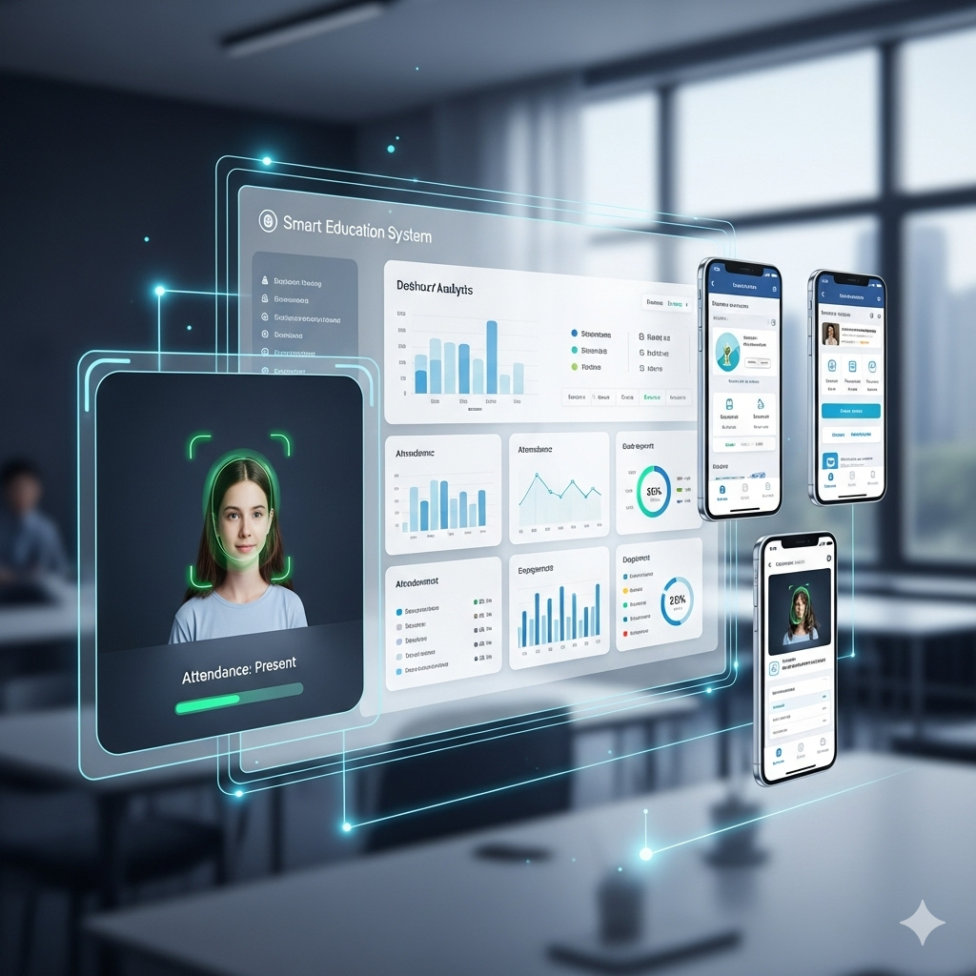
Problem
Statement
Title: Smart Innovation
Theme: Smart Education
Organization: AICTE
Department: AICTE, MIC-Student Innovation
NEXT

Slide 2
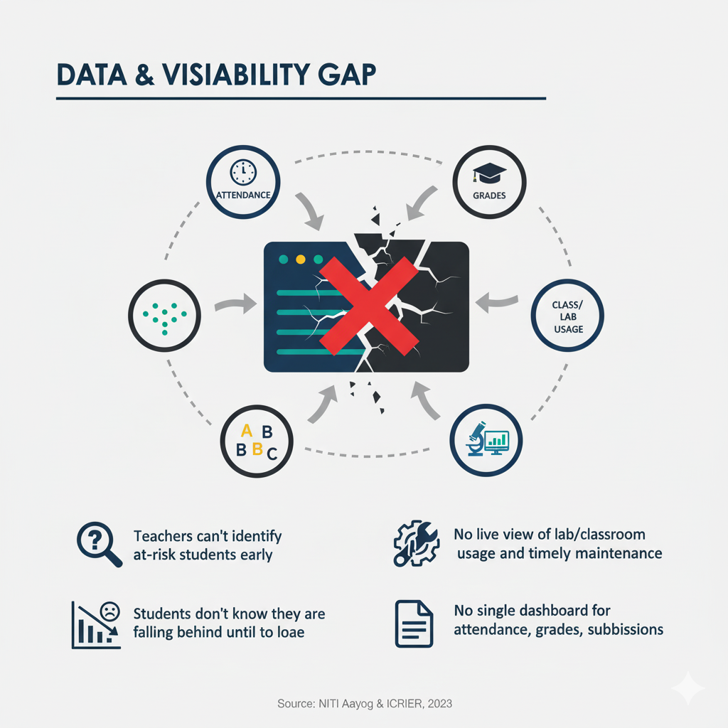
Pain Points
1
Attendance & Time Loss
8–10 mins wasted per class = 30+ lectures lost per year for every subject.
Causes Teachers Fatigue
Proxy attendance & Errors
2
Data Visibility & Analytics Gap
No single dashboard for attendance, grades, submissions
No live view of lab/classroom usage impedes timely intervention and maintenance.
Teachers can’t identify at-risk students early
Students don’t know they are falling behind until too late
4
4
3
Administrative Pain Points
Learning Gaps & Low Engagement
Hard to generate reports for management/NAAC
No analytics for decision-making (dropouts, low performers)
Disputes over attendance/marks take time due to no audit trail
Students skip classes; no personalized catch-up
Notes shared but no interactive revision
NEXT

Slide 3
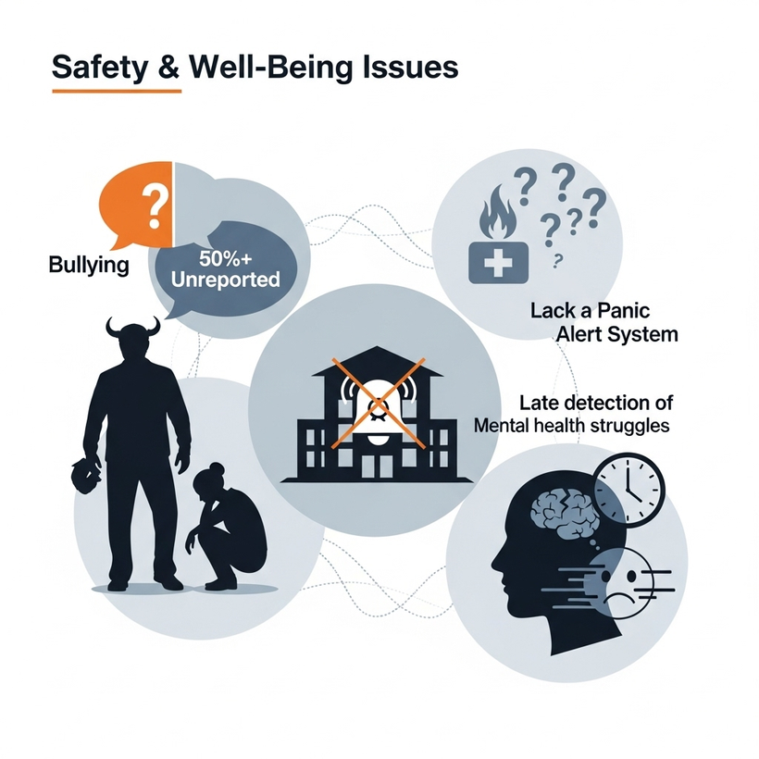
Pain Points
5
Assignment & Grading Pain Points
Manual grading overload delays results
Inconsistent marking → unfair scores
No instant test feedback → errors stay unnoticed , cannot improve before exams
Plagiarism detection is manual & slow
6
Communication & Engangement
Students miss updates about classes/assignments
No personalized nudges → all get generic info
Teachers can’t follow-up individually with 100+ student
7
Safety & Well-Being Issues
50%+ bullying cases go unreported (NCERT)
No panic alert system for fire/medical/security
Mental health struggles detected too late
NEXT

Slide 4
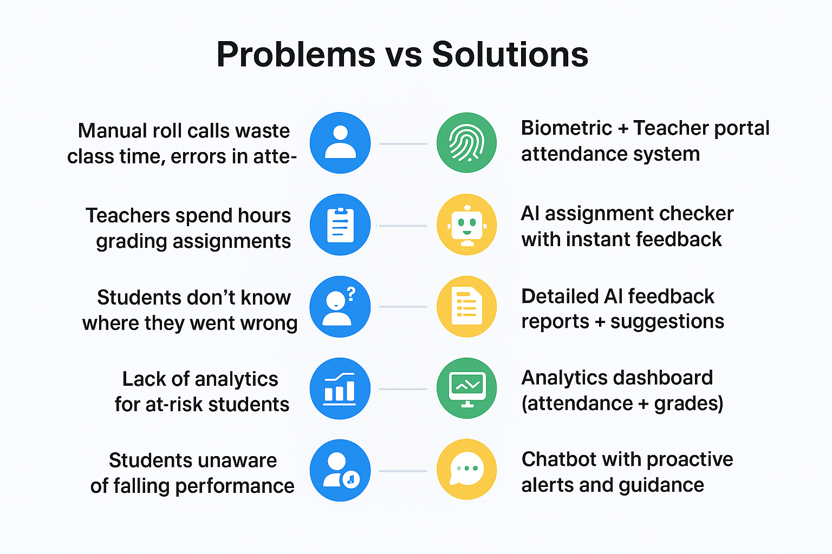
Turning Pain Points into Solutions

Slide 5
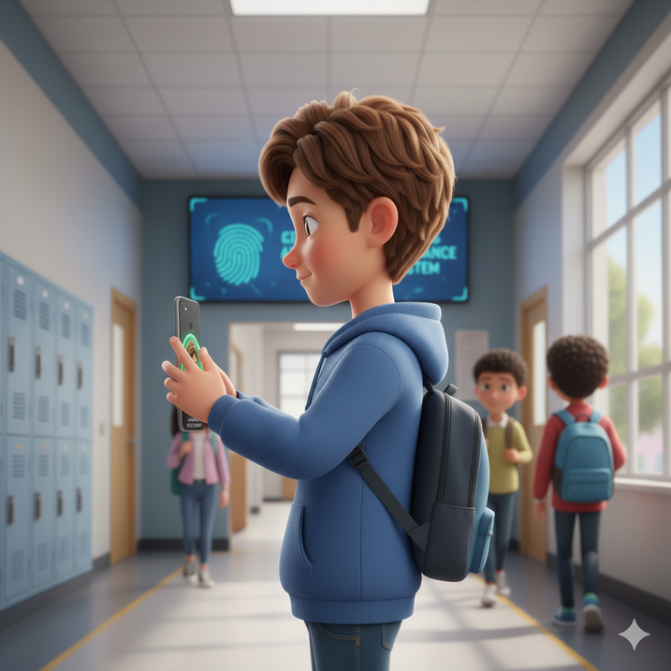
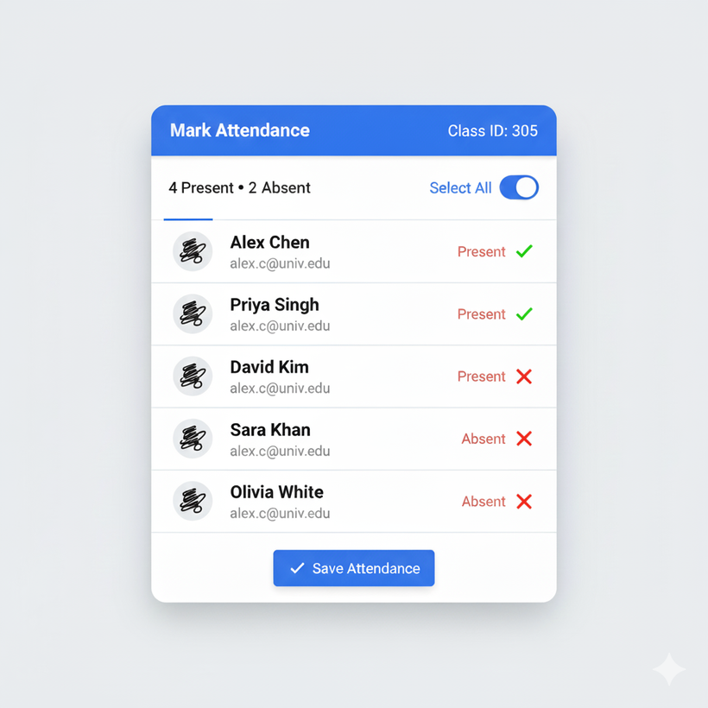
Attendance System
Our team is focused on the both modes of the attendance like on teacher side checklist attendance and biometric facial attendance from the students side.
Biometric Attendance from student side
From teacher Side Attendance
NEXT
2029

Slide 6
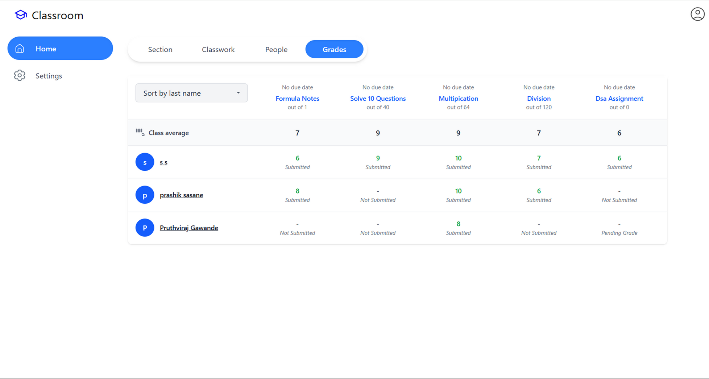
AI based Marking System
Teacher side Grades

Slide 7
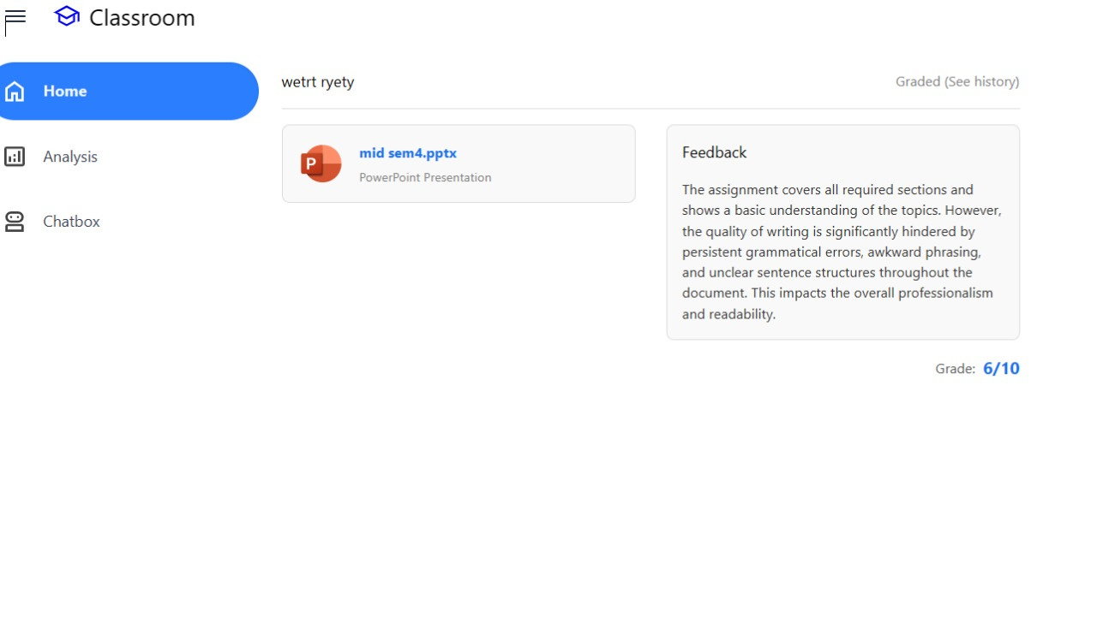
AI based Proper Feedback
Student Side Feedback

Slide 8
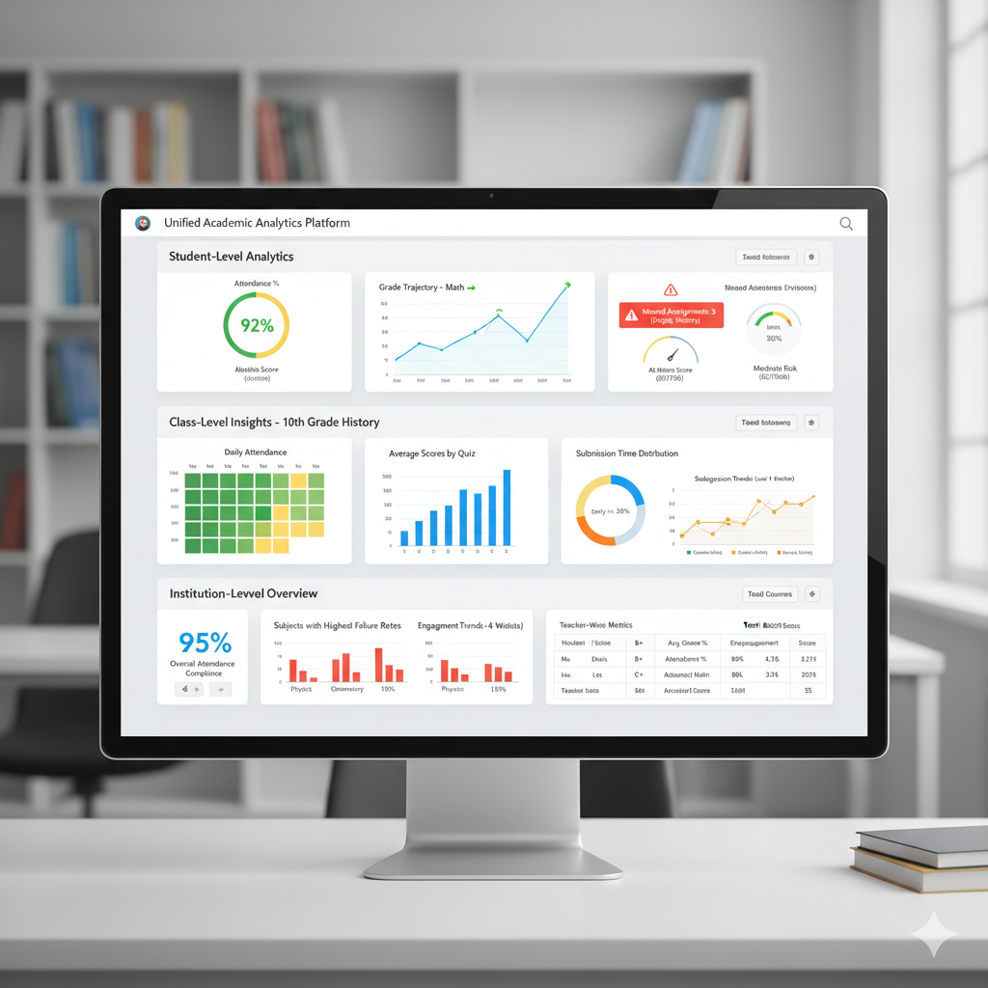
Unified Academic Analytics Dashboard
Educational Insights
The dashboard provides a comprehensive view of student, class, and institution-level performance, centralizing critical academic data.
Proactive Risk Identification
This diverse revenue model ensures long-term profitability and sustainable growth.
It features "at-risk" scores and alerts to quickly identify students who may need intervention, enabling timely support.
Data-Driven Decision Making
Designed to empower educators and administrators with actionable data to improve student outcomes, curriculum, and operational efficiency
NEXT
2029
Presentation Slide

Slide 9
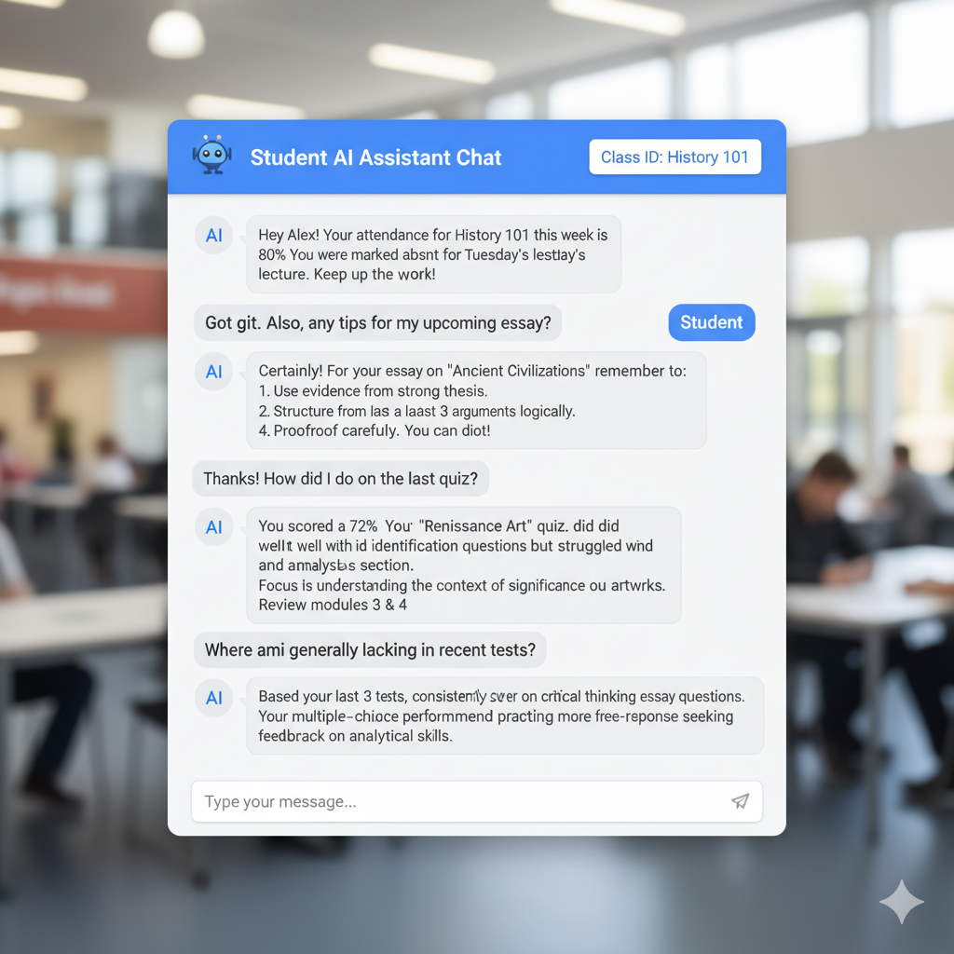
AI Chat Assistant
Personalized Student Support: The AI acts as a dedicated assistant, offering tailored information and guidance to individual students.
Instant Information Access: Students can quickly get answers to common questions about attendance, assignment due dates, or general advice without waiting for a human.
Performance Feedback & Guidance: The AI analyzes student performance (e.g., test scores, areas of weakness) and provides constructive feedback and recommendations for improvement.
Academic Advising & Tips: It can offer timely advice, such as essay writing tips or study strategies, based on the student's current needs or upcoming tasks.
NEXT

Slide 10
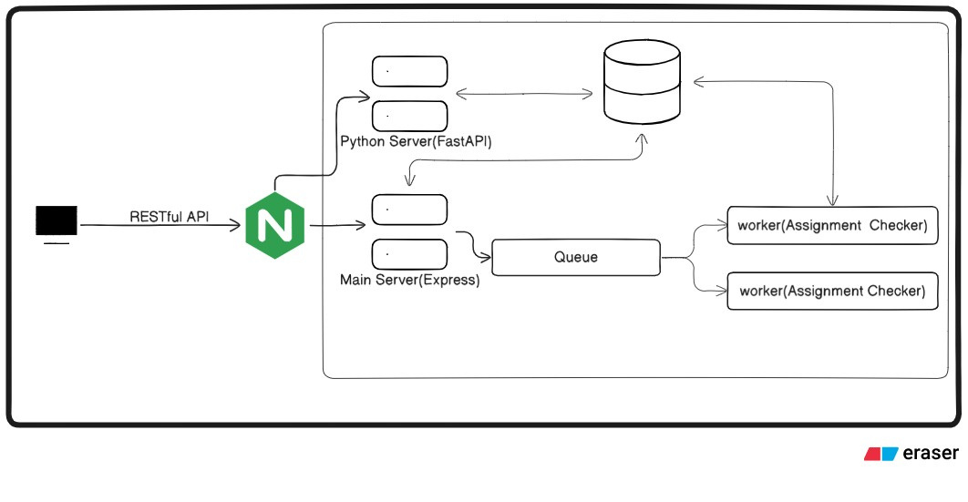
High-Level Architecture
NEXT
2029

Slide 11
Existing Systems vs Our Solution
Existing Systems | Our Feature | Impact
Manual/proxy attendance errors; separate marks & attendance; slow systems | Biometric + Teacher Portal Attendance & Unified Analytics Dashboard | Accurate tracking, no proxy, early detection of 80% at-risk students, 30+ hrs saved/semester
Assignments stored but not graded; delays in feedback | AI Assignment Checker with Instant Feedback | 70% faster grading, personalized student learning & improvement
Existing dashboards are passive; complex, admin-heavy | Google-like Interface + AI Chatbot with Proactive Alerts | Easy adoption, real-time nudges → higher engagement & accountability
Weak security; poor scalability, no offline | Encrypted Records, Hashed Biometrics, Cloud-Native & Offline-Ready | Privacy ensured, reliable for thousands of students, audit trail for disputes

